Slide 1
Chapter 14
Software Testing Techniques
Testing fundamentals
White-box testing
Black-box testing
Object-oriented testing methods
(Source: Pressman, R. Software Engineering: A Practitioner’s Approach. McGraw-Hill, 2005)

Slide 2
Characteristics of Testable Software
Operable
  The better it works (i.e., better quality), the easier it is to test
Observable
  Incorrect output is easily identified; internal errors are automatically detected
Controllable
  The states and variables of the software can be controlled directly by the tester
Decomposable
  The software is built from independent modules that can be tested independently

Slide 3
Characteristics of Testable Software
Simple
  The program should exhibit functional, structural, and code simplicity
Stable
  Changes to the software during testing are infrequent and do not invalidate existing tests
Understandable
  The architectural design is well understood; documentation is available and organized

Slide 4
Test Characteristics
A good test has a high probability of finding an error
  The tester must understand the software and how it might fail
A good test is not redundant
  Testing time is limited; one test should not serve the same purpose as another test
A good test should be “best of breed”
  Tests that have the highest likelihood of uncovering a whole class of errors should be used
A good test should be neither too simple nor too complex
  Each test should be executed separately; combining a series of tests could cause side effects and mask certain errors

Slide 5
Two Testing Techniques
Black-box testing
  Knowing the specified function that a product has been designed to perform, test to see if that function is fully operational and error free
  Includes tests that are conducted at the software interface
  Not concerned with internal logical structure of the software
White-box testing
  Knowing the internal workings of a product, test that all internal operations are performed according to specifications and all internal components have been exercised
  Involves tests that concentrate on close examination of procedural detail
  Logical paths through the software are tested
  Test cases exercise specific sets of conditions and loops

Slide 6
White-box Testing

Slide 7
White-box Testing
Uses the control structure part of component-level design to derive the test cases
These test cases
  Guarantee that all independent paths within a module have been exercised at least once
  Exercise all logical decisions on their true and false sides
  Execute all loops at their boundaries and within their operational bounds
  Exercise internal data structures to ensure their validity

Slide 8
Basis Path Testing
White-box testing technique proposed by Tom McCabe
Enables the test case designer to derive a logical complexity measure of a procedural design
Uses this measure as a guide for defining a basis set of execution paths
Test cases derived to exercise the basis set are guaranteed to execute every statement in the program at least one time during testing

Slide 9
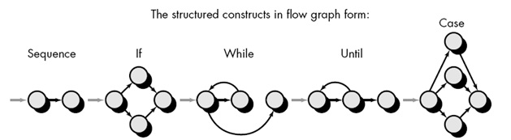
Flow Graph Notation
A circle in a graph represents a node
A node containing a simple conditional expression is referred to as a predicate node
  Each compound condition in a conditional expression containing one or more Boolean operators (e.g., and, or) is represented by a separate predicate node
  A predicate node has two edges leading out from it (True and False)
An edge, or a link, is a an arrow representing flow of control in a specific direction
  An edge must start and terminate at a node
  An edge does not intersect or cross over another edge
Areas bounded by a set of edges and nodes are called regions
When counting regions, include the area outside the graph as a region, too

Slide 10
Flow Graph Example
FLOW CHART
FLOW GRAPH
0
0
R4
1
1
2
2
3
R3
3
6
4
6
4
R2
7
8
5
R1
7
8
5
9
9
11
10
11
10

Slide 11
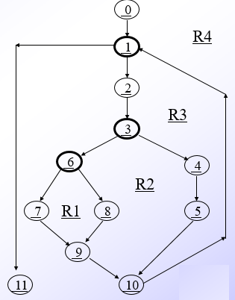
Independent Program Paths
Defined as a path through the program from the start node until the end node that introduces at least one new set of processing statements or a new condition (i.e., new nodes)
Must move along at least one edge that has not been traversed before by a previous path
Basis set for flow graph
  Path 1: 0-1-11
  Path 2: 0-1-2-3-4-5-10-1-11
  Path 3: 0-1-2-3-6-8-9-10-1-11
  Path 4: 0-1-2-3-6-7-9-10-1-11
The number of paths in the basis set is determined by the cyclomatic complexity

Slide 12
Cyclomatic Complexity
Provides a quantitative measure of the logical complexity of a program
Defines the number of independent paths in the basis set
Provides an upper bound for the number of tests that must be conducted to ensure all statements have been executed at least once
Can be computed in three ways
  The number of regions
  V(G) = E – N + 2, where E is the number of edges and N is the number of nodes in graph G
  V(G) = P + 1, where P is the number of predicate nodes in the flow graph G
Results in the following equations for the example flow graph
  Number of regions = 4
  V(G) = 14 edges – 12 nodes + 2 = 4
  V(G) = 3 predicate nodes + 1 = 4

Slide 13
Deriving the Basis Set and Test Cases
Using the design or code as a foundation, draw a corresponding flow graph
Determine the cyclomatic complexity of the resultant flow graph
Determine a basis set of linearly independent paths
Prepare test cases that will force execution of each path in the basis set

Slide 14
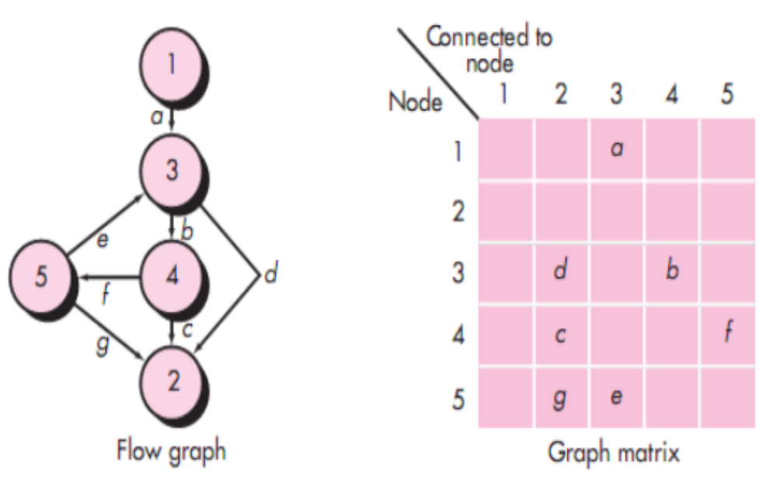
Graph Matrices

Slide 15
A Second Flow Graph Example
3
1 int functionY(void)
2 {
3 int x = 0;
4 int y = 19;
5 A: x++;
6 if (x > 999)
7 goto D;
8 if (x % 11 == 0)
9 goto B;
10 else goto A;
11 B: if (x % y == 0)
12 goto C;
13 else goto A;
14 C: printf("%d\n", x);
15 goto A;
16 D: printf("End of list\n");
17 return 0;
18 }
4
5
6
8
7
10
9
16
11
17
13
12
14
15

Slide 16
A Sample Function to Diagram and Analyze
1 int functionZ(int y)
2 {
3 int x = 0;
4 while (x <= (y * y))
5 {
6 if ((x % 11 == 0) &&
7 (x % y == 0))
8 {
9 printf(“%d”, x);
10 x++;
11 } // End if
12 else if ((x % 7 == 0) ||
13 (x % y == 1))
14 {
15 printf(“%d”, y);
16 x = x + 2;
} // End else
18 printf(“\n”);
19 } // End while
20 printf("End of list\n");
21 return 0;
22 } // End functionZ

Slide 17
A Sample Function to Diagram and Analyze
1 int functionZ(int y)
2 {
3 int x = 0;
4 while (x <= (y * y))
5 {
6 if ((x % 11 == 0) &&
7 (x % y == 0))
8 {
9 printf(“%d”, x);
10 x++;
11 } // End if
12 else if ((x % 7 == 0) ||
13 (x % y == 1))
14 {
15 printf(“%d”, y);
16 x = x + 2;
} // End else
18 printf(“\n”);
19 } // End while
20 printf("End of list\n");
21 return 0;
22 } // End functionZ
3
4
6
7
9
12
13
10
15
16
18
20
21

Slide 18
Loop Testing - General
A white-box testing technique that focuses exclusively on the validity of loop constructs
Four different classes of loops exist
  Simple loops
  Nested loops
  Concatenated loops
  Unstructured loops
Testing occurs by varying the loop boundary values
Examples:
for (i = 0; i < MAX_INDEX; i++)
while (currentTemp >= MINIMUM_TEMPERATURE)

Slide 19
Testing of Simple Loops
Skip the loop entirely
Only one pass through the loop
Two passes through the loop
m passes through the loop, where m < n
n –1, n, n + 1 passes through the loop
‘n’ is the maximum number of allowable passes through the loop

Slide 20
Testing of Nested Loops
Start at the innermost loop; set all other loops to minimum values
Conduct simple loop tests for the innermost loop while holding the outer loops at their minimum iteration parameter values; add other tests for out-of-range or excluded values
Work outward, conducting tests for the next loop, but keeping all other outer loops at minimum values and other nested loops to “typical” values
Continue until all loops have been tested

Slide 21
Testing of Concatenated Loops
For independent loops, use the same approach as for simple loops
Otherwise, use the approach applied for nested loops

Slide 22
Testing of Unstructured Loops
Redesign the code to reflect the use of structured programming practices
Depending on the resultant design, apply testing for simple loops, nested loops, or concatenated loops

Slide 23
Black-box Testing

Slide 24
Black-box Testing
Complements white-box testing by uncovering different classes of errors
Focuses on the functional requirements of the software
Used during the later stages of testing after white box testing has been performed
The tester identifies a set of input conditions that will fully exercise all functional requirements for a program
The test cases satisfy the following:
  Reduce the number of additional test cases that must be designed to achieve reasonable testing
  Tell us something about the presence or absence of classes of errors, rather than an error associated only with the specific task at hand

Slide 25
Black-box Testing Categories
Incorrect or missing functions
Interface errors
Errors in data structures or external database access
Behavior or performance errors
Initialization and termination errors

Slide 26
Questions answered by
Black-box Testing
How is functional validity tested?
How are system behavior and performance tested?
What classes of input will make good test cases?
Is the system particularly sensitive to certain input values?
How are the boundary values of a data class isolated?
What data rates and data volume can the system tolerate?
What effect will specific combinations of data have on system operation?

Slide 27
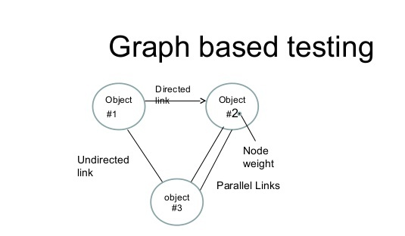
A graph drawing depicts the link between the causes (inputs) and the effects (output), which trigger the effects.
The test utilizes different combinations of output and inputs.
Helpful to understand the software’s functional performance, as it visualizes the flow of inputs and outputs in a lively fashion.

Slide 28
Equivalence Partitioning
Divides the input domain of a program into classes of data from which test cases are derived
An ideal test case single-handedly uncovers a complete class of errors, thereby reducing the total number of test cases that must be developed
Test case design is based on an evaluation of equivalence classes for an input condition
An equivalence class represents a set of valid or invalid states for input conditions
From each equivalence class, test cases are selected so that the largest number of attributes of an equivalence class are exercise at once

Slide 29
Guidelines for Defining Equivalence Classes
If an input condition specifies a range, one valid and two invalid equivalence classes are defined
  Input range: 1 – 10 Eq classes: {1..10}, {x < 1}, {x > 10}
If an input condition requires a specific value, one valid and two invalid equivalence classes are defined
  Input value: 250 Eq classes: {250}, {x < 250}, {x > 250}
If an input condition specifies a member of a set, one valid and one invalid equivalence class are defined
  Input set: {-2.5, 7.3, 8.4} Eq classes: {-2.5, 7.3, 8.4}, {any other x}
If an input condition is a Boolean value, one valid and one invalid class are define
  Input: {true condition} Eq classes: {true condition}, {false condition}

Slide 30
Boundary Value Analysis
A greater number of errors occur at the boundaries of the input domain rather than in the "center"
Boundary value analysis is a test case design method that complements equivalence partitioning
  It selects test cases at the edges of a class
  It derives test cases from both the input domain and output domain

Slide 31
Guidelines for
Boundary Value Analysis
If an input condition specifies a range bounded by values a and b, test cases should be designed with values a and b as well as values just above and just below a and b
If an input condition specifies a number of values, test case should be developed that exercise the minimum and maximum numbers. Values just above and just below the minimum and maximum are also tested
Apply guidelines 1 and 2 to output conditions; produce output that reflects the minimum and the maximum values expected; also test the values just below and just above
If internal program data structures have prescribed boundaries (e.g., an array), design a test case to exercise the data structure at its minimum and maximum boundaries

Slide 32
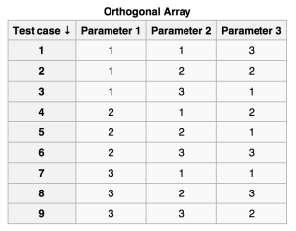
Orthogonal Array Test
used for small number of inputs, but with exhaustive number of possibilities
Identify the independent variables.
Identify the values which each variable will take.
Search for an orthogonal array that has all the factors from step 1 and all the levels from step 2
Map the factors and levels with your requirement and translate them into the suitable test cases
Look out for the left over or special test cases (if any)
Single Mode Faults - Single mode faults occur only due to one parameter.
Double Mode Fault - Double mode fault is caused by the two specific parameter values interacting together. Such an interaction is a harmful interaction between interacting parameters.
Multimode Faults - If more than two interacting components produce consistent erroneous output, then it is a multimode fault. The orthogonal array detects the multimode faults.

Slide 33
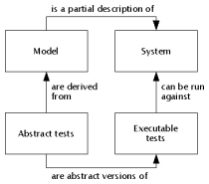
Model-based testing
Analyze an existing behavioral model for the software or create one
Traverse the behavioral model and specify the inputs that will force the software to make the transition from state to state
Review the behavioral model and note the expected outputs as the software makes the transition from state to state
Execute the test cases
Compare actual; and expected results and take corrective action as required.

Slide 34
Object-Oriented Testing Methods

Slide 35
Introduction
It is necessary to test an object-oriented system at a variety of different levels
The goal is to uncover errors that may occur as classes collaborate with one another and subsystems communicate across architectural layers
  Testing begins "in the small" on methods within a class and on collaboration between classes
  As class integration occurs, use-based testing and fault-based testing are applied
  Finally, use cases are used to uncover errors during the software validation phase
Conventional test case design is driven by an input-process-output view of software
Object-oriented testing focuses on designing appropriate sequences of methods to exercise the states of a class

Slide 36
Testing Implications for
Object-Oriented Software
Because attributes and methods are encapsulated in a class, testing methods from outside of a class is generally unproductive
Testing requires reporting on the state of an object, yet encapsulation can make this information somewhat difficult to obtain
Built-in methods should be provided to report the values of class attributes in order to get a snapshot of the state of an object
Inheritance requires retesting of each new context of usage for a class
  If a subclass is used in an entirely different context than the super class, the super class test cases will have little applicability and a new set of tests must be designed

Slide 37
Applicability of Conventional Testing Methods
White-box testing can be applied to the operations defined in a class
  Basis path testing and loop testing can help ensure that every statement in an method has been tested
Black-box testing methods are also appropriate
  Use cases can provide useful input in the design of black-box tests

Slide 38
Fault-based Testing
The objective in fault-based testing is to design tests that have a high likelihood of uncovering plausible faults
Fault-based testing begins with the analysis model
  The tester looks for plausible faults (i.e., aspects of the implementation of the system that may result in defects)
  To determine whether these faults exist, test cases are designed to exercise the design or code
If the analysis and design models can provide insight into what is likely to go wrong, then fault-based testing can find a significant number of errors

Slide 39
Fault-based Testing
(continued)
Integration testing looks for plausible faults in method calls or message connections (i.e., client/server exchange)
Three types of faults are encountered in this context
  Unexpected result
  Wrong method or message used
  Incorrect invocation
The behavior of a method must be examined to determine the occurrence of plausible faults as methods are invoked
Testing should exercise the attributes of an object to determine whether proper values occur for distinct types of object behavior
The focus of integration testing is to determine whether errors exist in the calling code, not the called code

Slide 40
Fault-based Testing
vs. Scenario-based Testing
Fault-based testing misses two main types of errors
  Incorrect specification: subsystem doesn't do what the user wants
  Interactions among subsystems: behavior of one subsystem creates circumstances that cause another subsystem to fail
A solution to this problem is scenario-based testing
  It concentrates on what the user does, not what the product does
  This means capturing the tasks (via use cases) that the user has to perform, then applying them as tests
  Scenario-based testing tends to exercise multiple subsystems in a single test

Slide 41
Random Order Testing
(at the Class Level)
Certain methods in a class may constitute a minimum behavioral life history of an object (e.g., open, seek, read, close); consequently, they may have implicit order dependencies or expectations designed into them
Using the methods for a class, a variety of method sequences are generated randomly and then executed
The goal is to detect these order dependencies or expectations and make appropriate adjustments to the design of the methods

Slide 42
Partition Testing (at the Class Level)
Similar to equivalence partitioning for conventional software
Methods are grouped based on one of three partitioning approaches
State-based partitioning categorizes class methods based on their ability to change the state of the class
  Tests are designed in a way that exercise methods that change state and those that do not change state
Attribute-based partitioning categorizes class methods based on the attributes that they use
  Methods are partitioned into those that read an attribute, modify an attribute, or do not reference the attribute at all
Category-based partitioning categorizes class methods based on the generic function that each performs
  Example categories are initialization methods, computational methods, and termination methods

Slide 43
Multiple Class Testing
Class collaboration testing can be accomplished by applying random testing, partition testing, scenario-based testing and behavioral testing
The following sequence of steps can be used to generate multiple class random test cases
  For each client class, use the list of class methods to generate a series of random test sequences; use these methods to send messages to server classes
  For each message that is generated, determine the collaborator class and the corresponding method in the server object
  For each method in the server object (invoked by messages from the client object), determine the messages that it transmits
  For each of these messages, determine the next level of methods that are invoked and incorporate these into the test sequence

Slide 44
Tests Derived from
Behavior Models
The state diagram for a class can be used to derive a sequence of tests that will exercise the dynamic behavior of the class and the classes that collaborate with it
The test cases should be designed to achieve coverage of all states
  Method sequences should cause the object to transition through all allowable states
More test cases should be derived to ensure that all behaviors for the class have been exercised based on the behavior life history of the object
The state diagram can be traversed in a "breadth-first" approach by exercising only a single transition at a time
  When a new transition is to be tested, only previously tested transitions are used
☺

